Slide 1
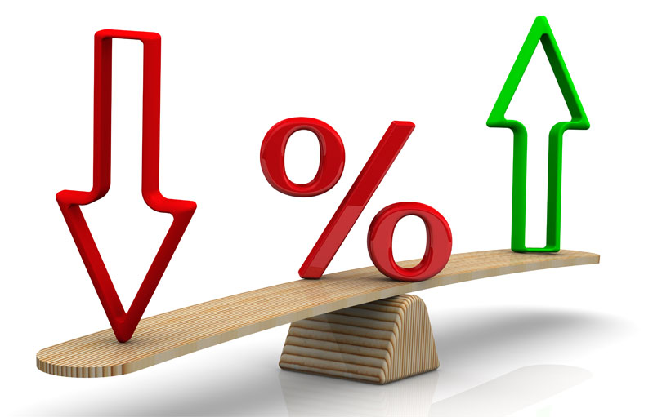
Financial Analytics using SQL: Trend Detection, Correlation Analysis, and Exchange Rate Forecasting
Using a small-scale time-series dataset, this project investigates trends in spot gold prices, the USD Index (DXY), and the USD to SEK exchange rate through exploratory SQL-based financial analytics.

Slide 2


Source of data
Datewise data were picked up on 3 following indices from 01.01.2024 to 31.05.2026.
XAU/SEK - Gold Spot Swedish Krona [price of 1 troy ounce of pure gold. 1 troy ounce = 31.1035 grams]
Denoted by “gold_price”
Source: https://www.investing.com/currencies/xau-sek-historical-data
- H.10 Statistical Release - Daily Indexes by Federal Reserve that reports daily measures of the foreign exchange value USD
against baskets of currencies. We took Nominal Broad Dollar Index which is weighted against currencies of major US
trading partners worldwide as SEK lies in this group [how much strong is USD against SEK]
Denoted by “dollar_index”
Source: https://www.federalreserve.gov/datadownload/Choose.aspx?rel=H10
DEXSDUS Spot Exchange Rate [SEK per USD]
Denoted by “rate”
Source: https://fred.stlouisfed.org/series/DEXSDUS
Consequently, I got 3 tables named as
- gold_price_table
- index_table
- rate_table

Slide 3

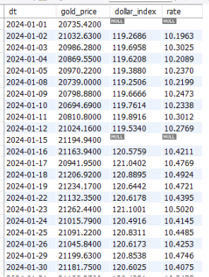
Joining 3 Dataset
I combined the gold_price_table, index_table, and rate_table by matching their common date column. This date-wise merge created a single unified dataset where each row represents one trading date and contains the corresponding gold price, dollar index, and USD to SEK exchange rate.
The combined dataset was then used for further analysis of trends, fluctuations, and relationships among the three financial variables.
Script name: joining

Slide 4
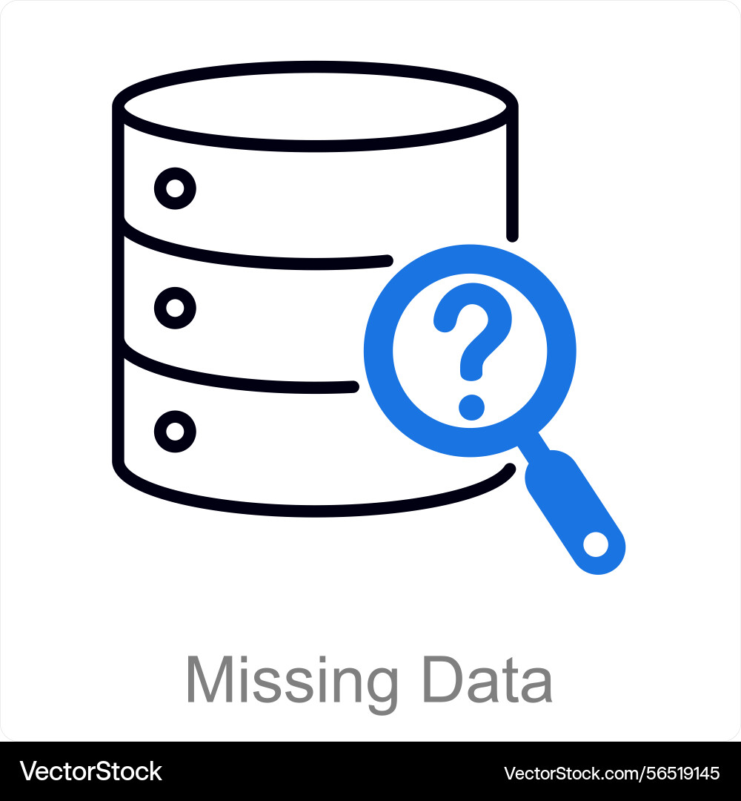
Missing Value Treatment
As the data were collected from a well-established and reliable source, I did not have to perform any data cleaning. All I needed to perform was handling missing values. Although I could have removed the observations containing missing values, I decided not to do so because the dataset already contained a limited number of observations. Instead, I filled the missing values using linear interpolation to preserve the continuity of the time series.
The missing value was calculated as
Missing Value = (Previous Value + Following Value) / 2
If the immediate previous or following observation was also missing, I used the nearest available previous and next observations. In other words, the missing value was estimated by taking the average of the closest available observations before and after the missing point.
However, as the first and last observations did not have previous and following values, respectively, I kept them unchanged if they contained missing values.
Script name: treating mv

Slide 5
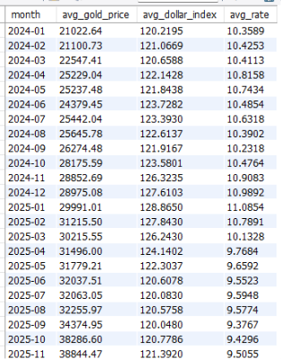
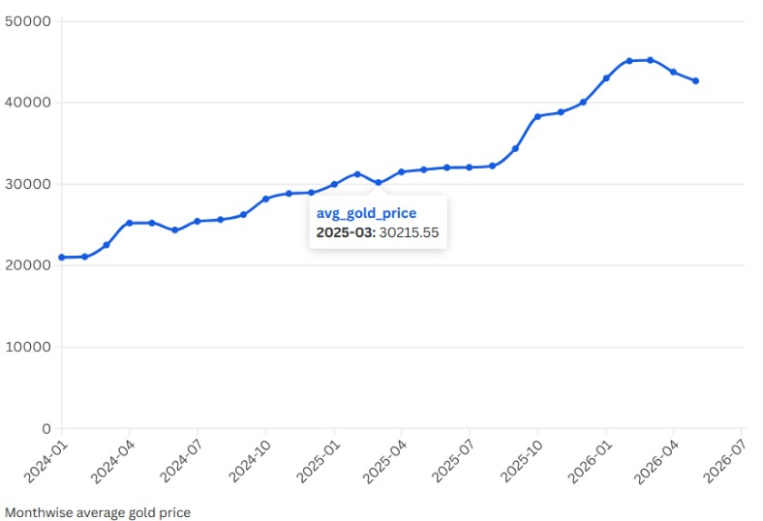
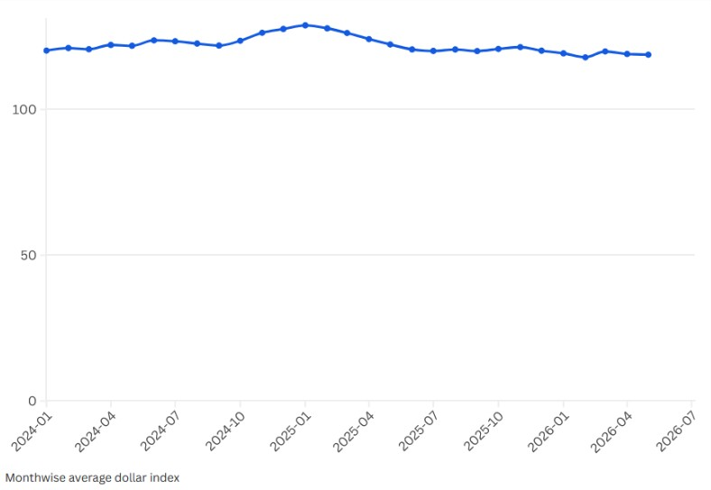
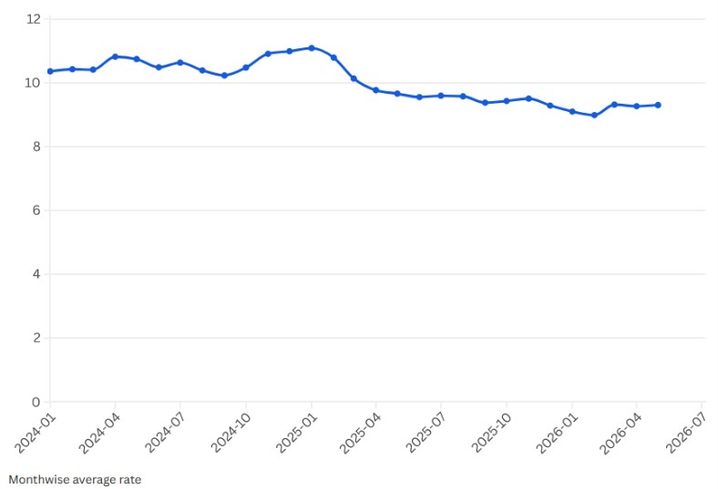
Q1: Show the month-wise trend of the 3 indices.
Month-wise average gold price
Month-wise average dollar index
Comment:
Gold prices follow an upward trend, whereas the Dollar Index and USD to SEK exchange rate decline after early 2025.
These contrasting movements suggest differing market dynamics and motivate further analysis.
Script name: 1_monthwise_average
Month-wise average rate

Slide 6
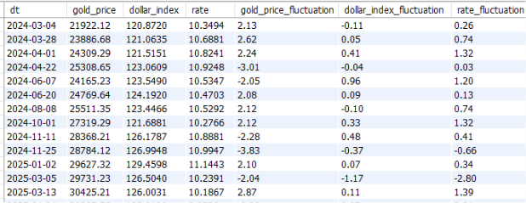
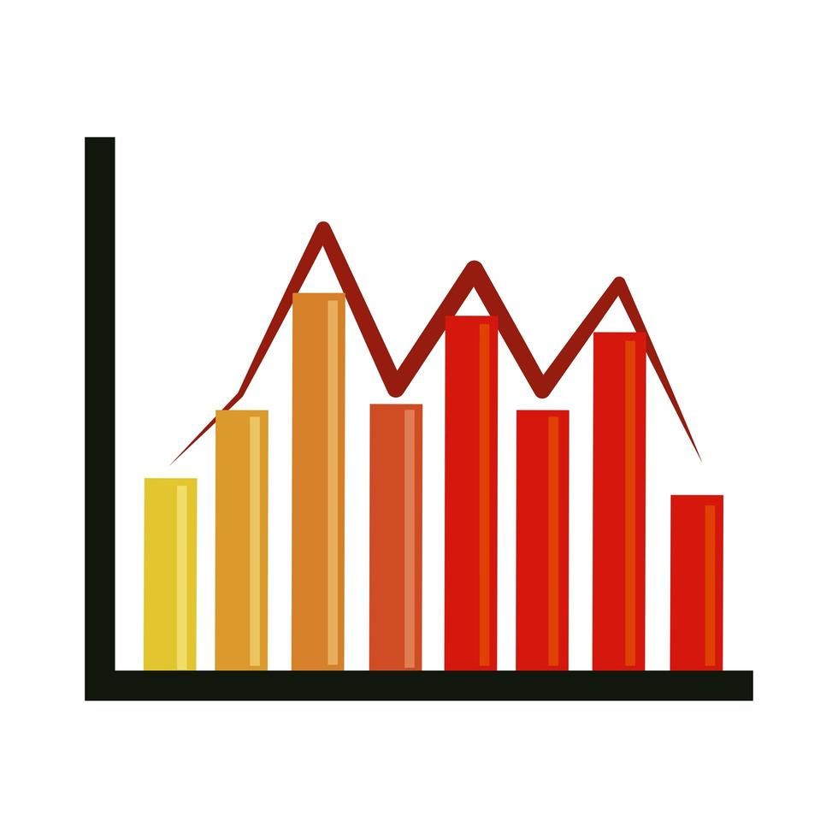
Q2: Find the severe fluctuations dates. Among the indices which index is the most volatile one? Which is the least?
Among the indices, gold price shows the highest volatility, indicating more frequent and larger day-to-day fluctuations. The USD to SEK exchange rate shows moderate variability, while the dollar index is the most stable throughout the study period.
This suggests that movements in gold prices were considerably more dynamic than those of the two dollar-related indicators.
Script name: 2_fluctuation

Slide 7
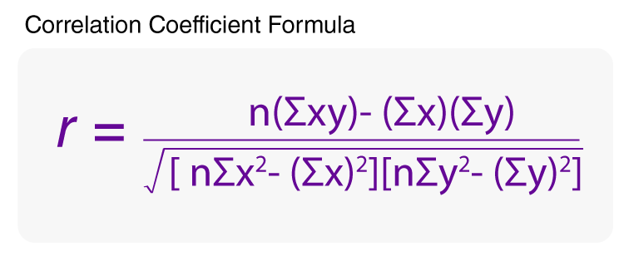
Q3: Is there any correlation between dollar index and USD to SEK rate?
Correlation between dollar_index and rate = 0.77
Comment:
The correlation between the Dollar Index and USD to SEK exchange rate in levels is 0.77, indicating a strong positive association. This is consistent with economic intuition because a stronger U.S. dollar generally increases the USD to SEK exchange rate.
However, because both variables are time-series levels, this correlation may partly capture common movements over time and persistence in the series. Therefore, correlation based on daily returns is required to assess whether short-term changes in the Dollar Index are associated with corresponding changes in USD to SEK.
Script name: 3_correlation_dollar_index_vs_rate

Slide 8

Q4: Is there any correlation between percentage change in dollar_index and percentage change in rate?
Correlation between pct change in dollar_index and pct change in rate = 0.81
Comment:
The correlation between the daily percentage changes of the Dollar Index and the USD to SEK exchange rate is 0.81, indicating a strong positive relationship. This means that on days when the Dollar Index increases, the USD to SEK exchange rate also tends to increase, and vice versa. The correlation is calculated using daily percentage changes, so the effect of common trends over time is reduced. Therefore, this result more reliably shows the overall relationship between movements in the Dollar Index and the USD to SEK exchange rate in limited period.
Although the return correlation is strong, correlation alone does not imply causation. Both variables may respond simultaneously to common macroeconomic factors.
Script name: 4_correlation_dollar_index_pct_chng vs_rate_pct_chng

Slide 9

Q5: Is there any correlation between percentage change in gold_price and percentage change in rate?
Correlation between pct change in gold_price and pct change in rate = 0.08
Comment:
The correlation between daily percentage changes in gold prices and the USD to SEK exchange rate is 0.08, indicating almost no relationship between their daily movements.
Unlike the Dollar Index, which shows a strong connection with USD to SEK, changes in gold prices do not appear to have a meaningful impact on daily USD to SEK movements.
This suggests that gold prices and the Swedish krona exchange rate are mainly influenced by different market factors.
However, this conclusion is based only on Pearson correlation, which measures linear association and does not capture possible non-linear relationships or delayed effects between the variables. Therefore, the weak correlation suggests limited linear dependency, but it does not completely rule out other forms of interaction between gold prices and the exchange rate.
Script name: 5_correlation_gold_price_pct_chng_vs_rate_pct_chng

Slide 10
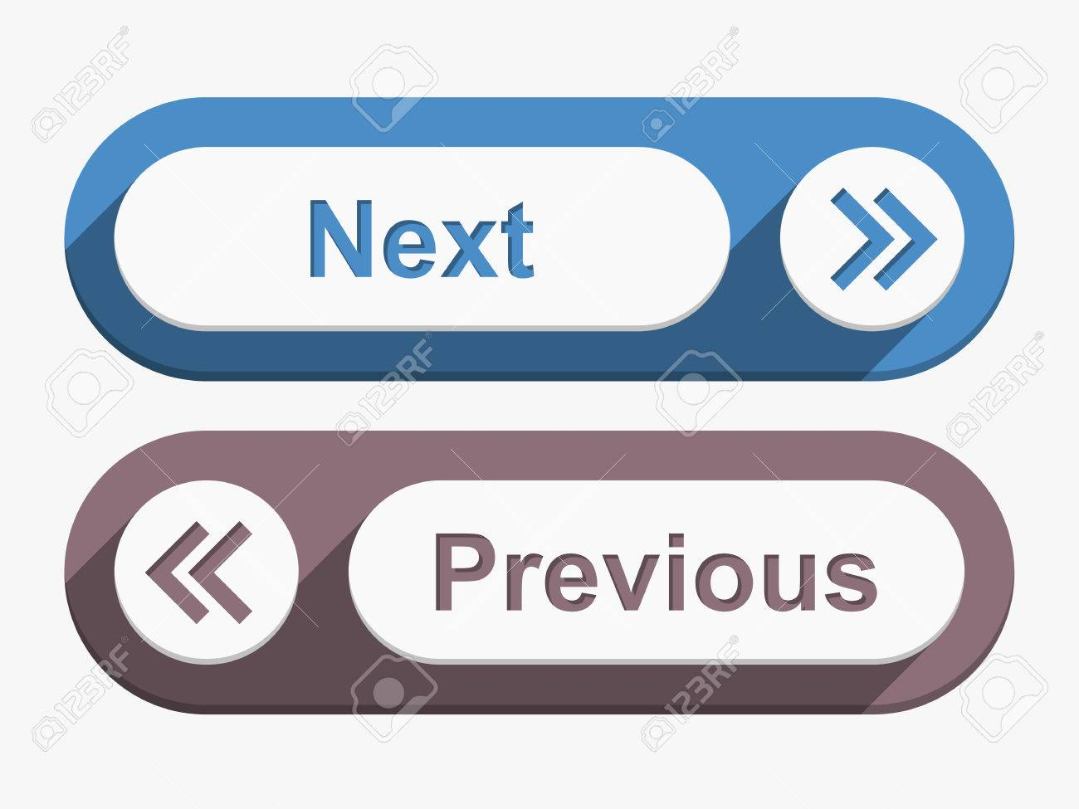
Q6: Does yesterday's Dollar Index influence today's USD to SEK rate?
Correlation between previous day dollar_index and present day USD to SEK rate = 0.76
Comment:
A lag correlation of 0.76 indicates a strong positive relationship between yesterday's Dollar Index and today's USD to SEK exchange rate. This suggests that when the U.S. dollar strengthens globally, the Swedish krona often weakens against the dollar on the following trading day. The result also implies that changes in the Dollar Index may precede movements in the USD to SEK exchange rate, indicating a possible lead–lag relationship rather than only a same-day association.
However, this is a measure of association, not causation, so other economic and market factors may also contribute to the exchange rate movements.
Script name: 6_correlation_lag_dollar_index_vs_rate

Slide 11
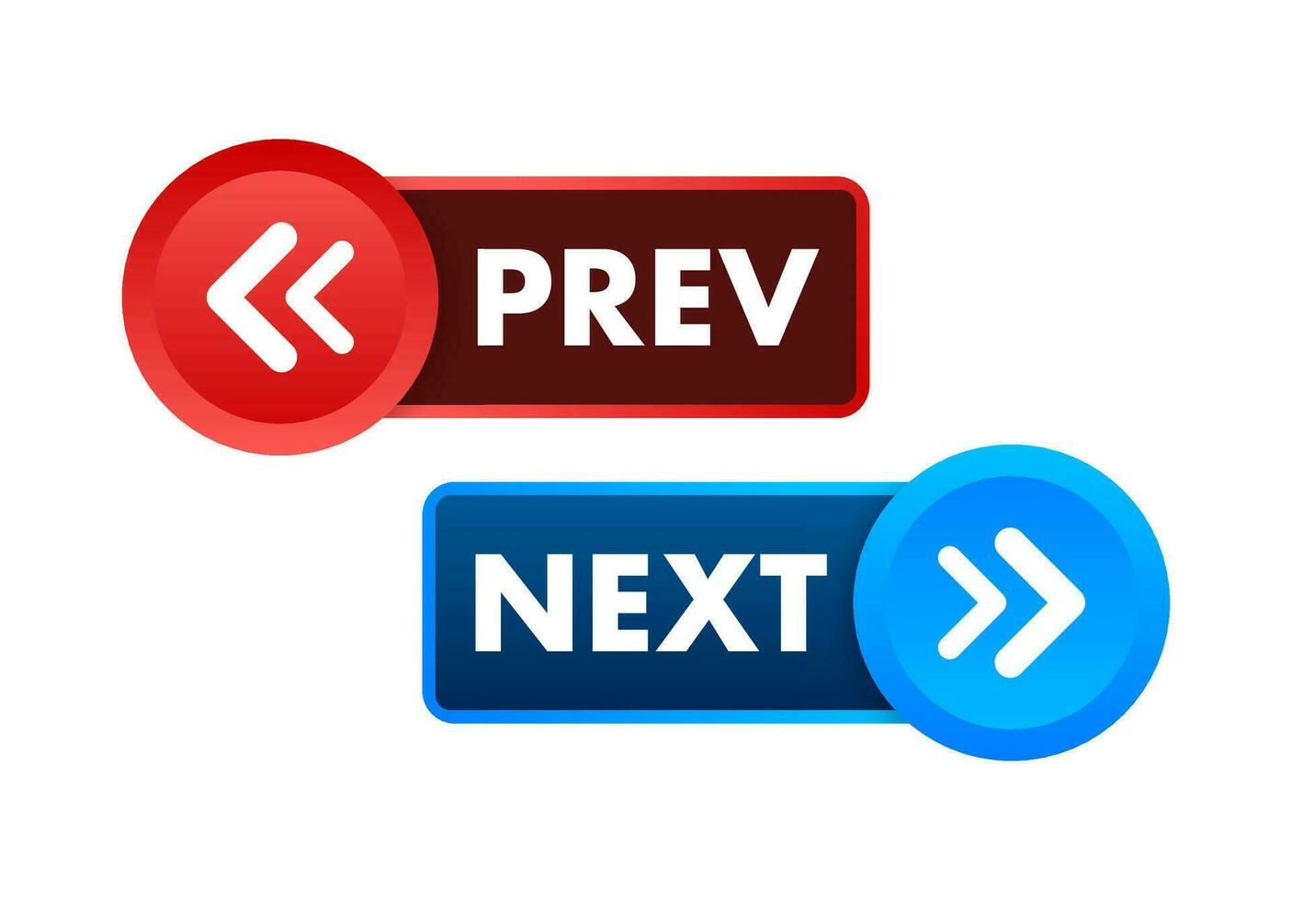
Q7: Does yesterday's Gold Price influence today's USD to SEK rate?
Correlation between previous day gold_price and present day USD to SEK rate = -0.79
Comment:
A lag correlation of −0.79 indicates a strong negative relationship between yesterday's gold price and today's USD to SEK exchange rate. This suggests that higher gold prices are often followed by a lower USD to SEK exchange rate on the next trading day, implying an appreciation of the Swedish krona against the U.S. dollar. The strong negative association also indicates that movements in the gold market may precede changes in the exchange rate, making gold prices a potentially useful leading indicator.
However, this relationship reflects association rather than causation, and other economic and financial factors may also influence exchange rate movements.
Script name: 7_correlation_lag_gold_price_vs_rate

Slide 12

Q8: What is the probability that the USD to SEK rate increases on the 2nd day, given that it increased on the 1st day?
Probability of an increased rate in 2nd day given an increased rate in 1st day is 0.49.
Comment:
The probability of an increased USD to SEK rate on the second day, given that the rate increased on the first day, is 0.49. This result weakens the possibility of predicting the next day's movement based solely on the current day's increase. Since the probability is very close to 0.50, there is no clear tendency for an increase to be followed by another increase. In other words, a positive movement on the current day does not create any noticeable advantage in anticipating a similar movement on the following day. This suggests that consecutive daily increases occur almost randomly rather than following a consistent continuation pattern.
Script name: 8_prob_of_2nd_day_rate_increase_given_1st_day_rate_increase

Slide 13
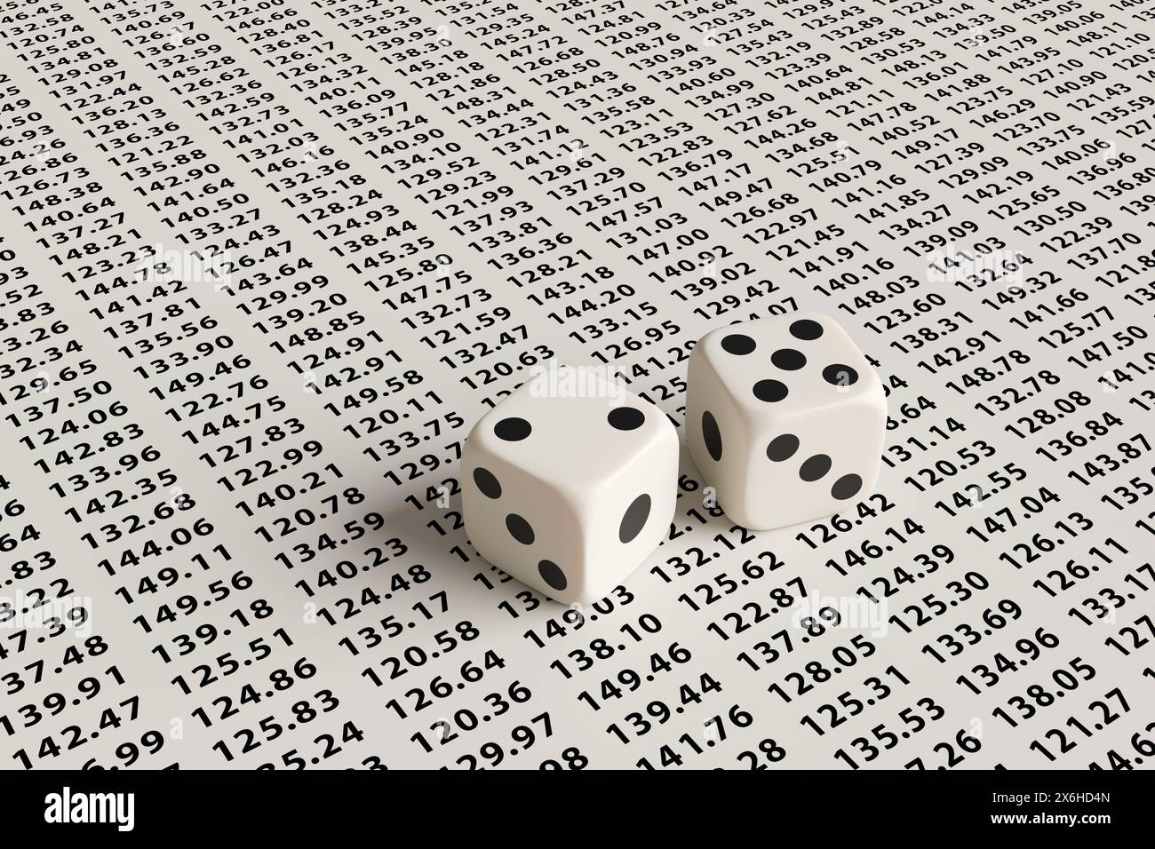
Q9: What is the probability that the USD to SEK rate increases on the 3rd day, given that it increased on the 1st and 2nd day?
Probability of an increased rate in 3rd day given an increased rate in 1st and 2nd day is 0.50.
Comment:
The probability of an increased rate on the third day, given that the rate increased on the previous two consecutive days, is 0.50. This indicates that even after observing two successive days of increases, there is no additional evidence of a continued upward movement on the following day. The probability remains almost equal to a random outcome, suggesting that a two-day increase pattern does not provide a reliable signal for predicting the next day's direction. Therefore, consecutive increases in USD to SEK rate do not appear to create any reliable momentum effect for the following day.
Script name: 9_prob_of_3rd_day_rate_increase_given_1st_and_2nd_day_rate_increase

Slide 14

Q10: What is the probability of a opposite direction change in USD to SEK rate on the 2nd day given that it changed substantially on 1st day?
Probability of a opposite direction change in USD to SEK rate on the 2nd day given that it changed substantially (absolute percentage change in 1 day greater than 0.5%) on 1st day is 0.55.
Comment:
Given that the USD to SEK rate experienced a large movement (absolute percentage change in 1 day greater than 0.5%), the probability of a reversal on the following day is 0.55. This indicates that large daily movements are followed by an opposite movement slightly more often than not.
However, since the probability is only slightly higher than 0.50, the evidence of a reversal pattern is weak. Therefore, a large movement may sometimes be followed by a correction, but it cannot be considered a reliable indicator for predicting the next day's direction.
Actually, the result suggests that extreme daily changes show a slight tendency to reverse, but the pattern is not strong enough to support a consistent prediction rule.
Script name: 10_prob_of_2nd_day_opposite_rate_change_given_1st_day_huge_rate_change

Slide 15

Further scope
Initially, the correlation between dollar index and USD to SEK exchange rate looked promising but it actually didn't lead to any reliable way of forecasting the exchange rate. The lag analysis was equally disappointing, revealing no consistent trend or predictive pattern.
After trying different SQL queries and statistical analyses, I found the fact that, this dataset alone is simply not enough to uncover how the USD to SEK exchange rate behaves. That doesn't mean the search has to end here.
If you are curious to explore further, you can expand the dataset by incorporating additional economic and market variables such as interest rates, inflation, crude oil prices, stock market indices, central bank policy decisions, and major geopolitical events. These factors may provide deeper insights into the complex forces influencing the USD to SEK exchange rate.
Perhaps you will be the one who finally discovers a reliable way to forecast currency movements. If you uncover a hidden pattern, congratulations, you may have found something truly valuable. Now go get rich!

